Slide 1



In the name of God
Auto Encoders

Slide 2
Auto Encoders
An unsupervised deep learning algorithm
Are artificial neural networks
Useful for dimensionality reduction and clustering
Unlabeled data
𝑥^ is 𝑥’s reconstruction
𝑧 is some latent representation or code and 𝑠 is a non-linearity such as the sigmoid
𝑥
𝑧
Decoder
𝑥^
𝑧 = 𝑠 𝑤𝑥 + 𝑏
𝑥^ = 𝑠 𝑤′z + 𝑏′
Encoder

Slide 3

Auto Encoders
Simple structure:
𝒙_{𝟏}
Hidden
𝒙˜_{𝟏}
Reconstructed Output
Input
𝒙_{𝟐}
𝒙˜_{𝟐}
𝒙_{𝟑}
𝒙˜_{𝟑}
Encoder
Decoder

Slide 4


Undercomplete AE
Hidden layer is Undercomplete if smaller than the input
layer
Compresses the input
Hidden nodes will be Good features for the training
𝑥^
𝑤′
𝑧
𝑤
𝑥

Slide 5

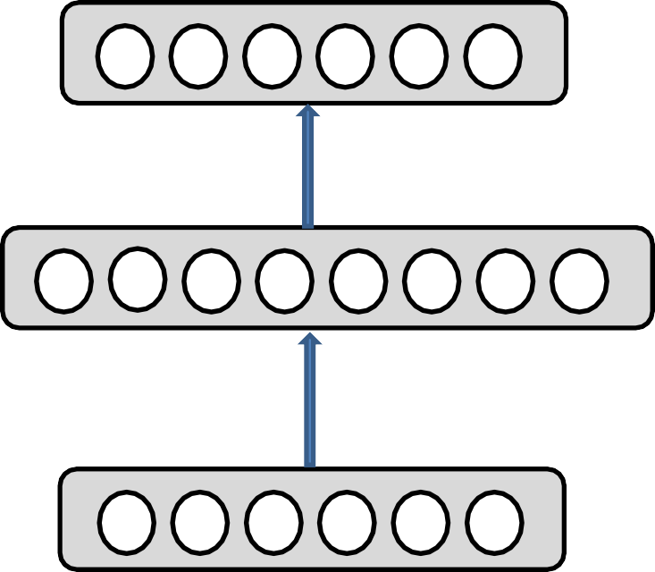
Overcomplete AE
Hidden layer is Overcomplete if greater than the input layer
No compression in hidden layer.
Each hidden unit could copy a different input component.
𝑥^
𝑤′
𝑧
𝑤
𝑥

Slide 6

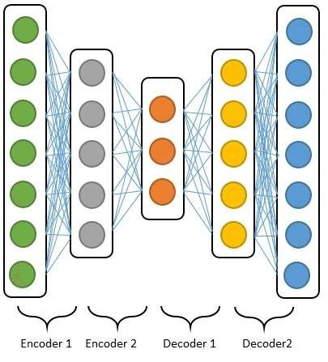
Deep Auto Encoders
Deep Auto Encoders (DAE)
Stacked Auto Encoders (SAE)

Slide 7



Training Deep Auto Encoder
First layer:
𝒙_{𝟏}
𝒙^_{𝟏}
𝒂_{𝟏}
𝒙_{𝟐}
𝒙^_{𝟐}
𝒂_{𝟐}
𝒙_{𝟑}
𝒙^_{𝟑}
𝒂_{𝟑}
𝒙_{𝟒}
𝒙^_{𝟒}
Encoder
Decoder

Slide 8


Training Deep Auto Encoder
Features of first layer:
𝒙_{𝟏}
𝒂_{𝟏}
𝑎₁
𝑎₂
𝑎₃
𝒙_{𝟐}
𝒂
𝟐
𝒙_{𝟑}
𝒂_{𝟑}
𝒙_{𝟒}

Slide 9


Training Deep Auto Encoder
Second layer:
𝒂_{𝟏}
𝒂^_{𝟏}
𝒃_{𝟏}
𝒂_{𝟐}
𝒂^_{𝟐}
𝒃_{𝟐}
𝒂_{𝟑}
𝒂^_{𝟑}

Slide 10

Training Deep Auto Encoder
Features of second layer:
𝒙_{𝟏}
𝒂_{𝟏}
𝒃_{𝟏}
𝒙_{𝟐}
𝑏₁
𝑏₂
𝒂_{𝟐}
𝒙_{𝟑}
𝒃_{𝟐}
𝒂_{𝟑}
𝒙_{𝟒}

Slide 11



Using Deep Auto Encoder
Feature extraction
Dimensionality reduction
Classification
𝒙_{𝟏}
𝒂_{𝟏}
𝒃_{𝟏}
𝒙_{𝟐}
Inputs
𝒂_{𝟐}
Features
𝒙_{𝟑}
𝒃_{𝟐}
𝒂_{𝟑}
𝒙_{𝟒}
Encoder

Slide 12

Using Deep Auto Encoder
Reconstruction
𝒙_{𝟏}
𝒙^_{𝟏}
𝒂_{𝟏}
𝒂^_{𝟏}
𝒃_{𝟏}
𝒙_{𝟐}
𝒙^_{𝟐}
𝒂_{𝟐}
𝒂^_{𝟐}
𝒙_{𝟑}
𝒃_{𝟐}
𝒙^_{𝟑}
𝒂_{𝟑}
𝒂^_{𝟑}
𝒙_{𝟒}
𝒙^_{𝟒}
Encoder
Decoder

Slide 13


Using AE
Denoising
Data compression
Unsupervised learning
Manifold learning
Generative model

Slide 14


Types of Auto Encoder
Stacked auto encoder (SAE)
Denoising auto encoder (DAE)
Sparse Auto Encoder (SAE)
Contractive Auto Encoder (CAE)
Convolutional Auto Encoder (CAE)
Variational Auto Encoder (VAE)

Slide 15


Generative Models
Given training data, generate new samples from same
distribution
Variational Auto Encoder (VAE)
Generative Adversarial Network (GAN)

Slide 16


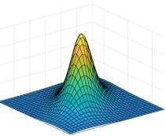

Variational Auto Encoder
Encoder
Decoder
𝒙_{𝟏}
𝒙˜_{𝟏}
𝒙_{𝟐}
𝒙˜_{𝟐}
𝒛_{𝟏}
𝒙_{𝟑}
𝒛_{𝟐}
𝒙˜_{𝟑}
𝒙_{𝟒}
Input
x
𝒙˜_{𝟒}
Output
𝐱˜
𝒒 𝒛|𝒙
𝒑_{𝜽} 𝒙|𝒛
∅

Slide 17

Variational Auto Encoder
Use probabilistic encoding and decoding
Encoder:
Decoder:
𝑞∅ 𝑧|𝑥
𝑝_{𝜃} 𝑥|𝑧
x: Unknown probability distribution
z: Gaussian probability distribution

Slide 18


Training Variational Auto Encoder
Latent space:
𝒙_{𝟏}
𝒉_{𝟏}
Mean
1 dimensional Gaussian probability distribution
𝝁
𝒙
𝟐
𝒉_{𝟐}
𝒛 𝑞∅ 𝑧|𝑥
𝝈
𝒙_{𝟑}
𝒉_{𝟑}
Variance
𝒙_{𝟒}
If we have n neurons for 𝝈 and 𝝁 then we have n dimensional distribution

Slide 19
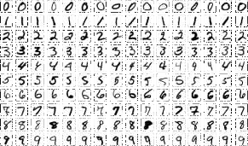
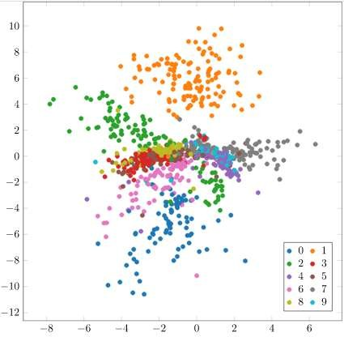
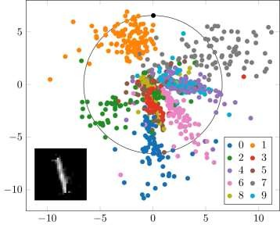

Training Variational Auto Encoder
Generating new data:
– Example: MNIST Database
Encoder
Decoder
𝐱
Latent space

Slide 20


Generative Adversarial Network
VAE:
x
Encoder
z
Decoder
𝐱˜
GAN:
z
Generator
𝐱˜
Fake or real?
Discriminator
Loss
x
Can generate samples
Trained by competing each other
Use neural network
Z is some random noise (Gaussian/Uniform).
Z can be thought as the latent representation of the image.

Slide 21




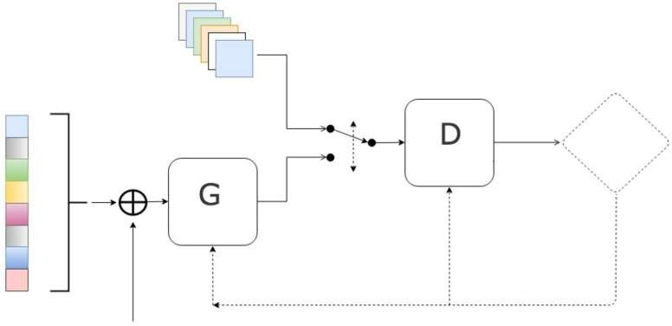
GAN’s Architecture
Overview:
Real samples
Latent space
Discriminator
Is D correct?
Generator
Generated fake samples
Fine tune training
Noise

Slide 22

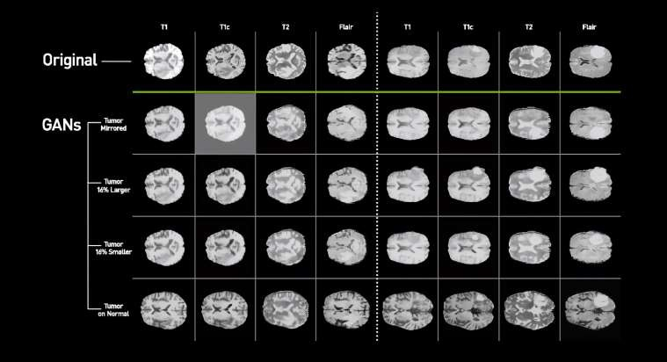

Using GAN
Image generation:

Slide 23
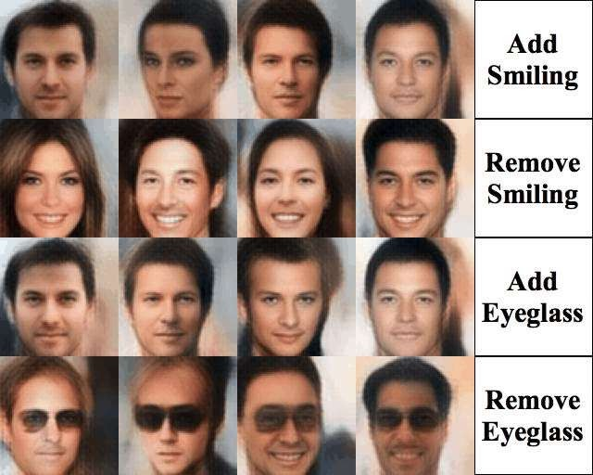

Using GAN
Data manipulation:

Slide 24


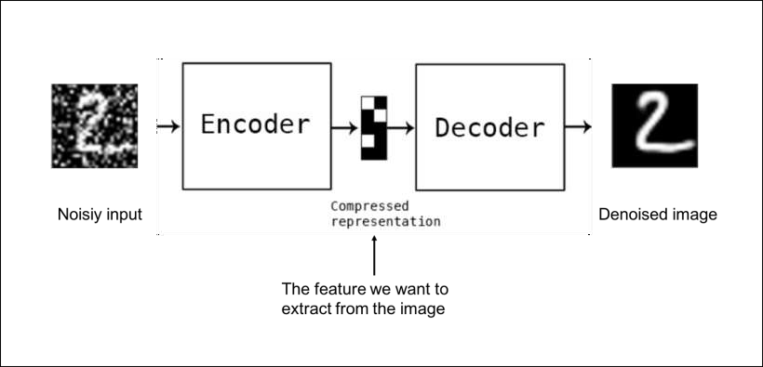

Denoising Auto Encoder
Add noise to its input, and train it to recover this original.

Slide 25

Denoising Auto Encoder
Output
Output
Hidden 3
Hidden 3
Hidden 2
Hidden 2
Hidden 1
Hidden 1
Noise
+
Dropout
Input
Input
Gaussian noise
Randomly switched input

Slide 26

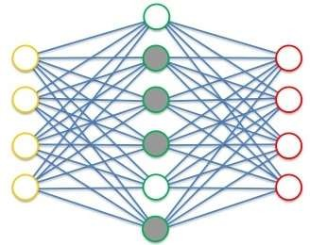

Sparse Auto Encoder
Reduce the number of active neurons in the coding layer.
Add sparsity loss into the cost function.
Sparsity loss:
Kullback-Leibler(KL) divergence is commonly used.

